Slide 1
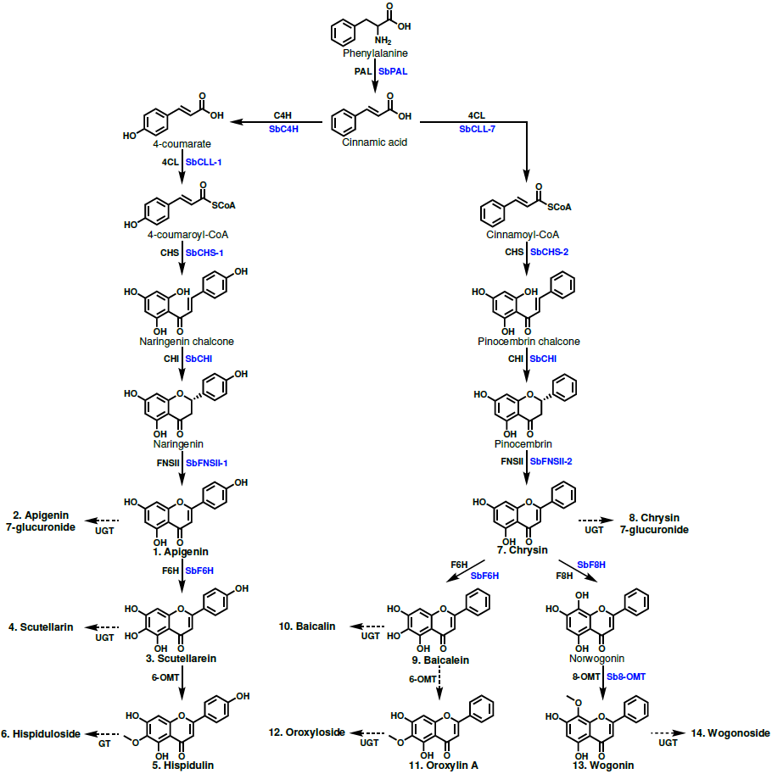
Figure 1. Proposed 4´-hydroxyflavone and 4´-deoxyflavone pathway. Structures of glycosylated flavones are not shown to save space but are included in Fig. S1. Enzyme names in blue are specific isoforms that have been identified in S. baicalensis, and enzyme names in black are general names. Flavones that were quantified have names in bold and are numbered to match the labeling of Figure 2.
Enzymes are phenylalanine ammonia lyase (SbPAL), cinnamate 4-hydroxylase (SbC4H), cinnamate-CoA ligase (SbCLL-7), 4-coumarate CoA ligase (SbCLL-1), chalcone synthase (SbCHS-1), pinocembrin-chalcone synthase (SbCHS-2), chalcone isomerase (SbCHI), flavone synthase I (SbFNSI), flavone synthase II (SbFNSII), flavone 6-hydroxylase (SBF6H), flavone 8-hydroxylase (SbF8H), and 8-O-methyl transferase (Sb8-OMT).

Slide 2
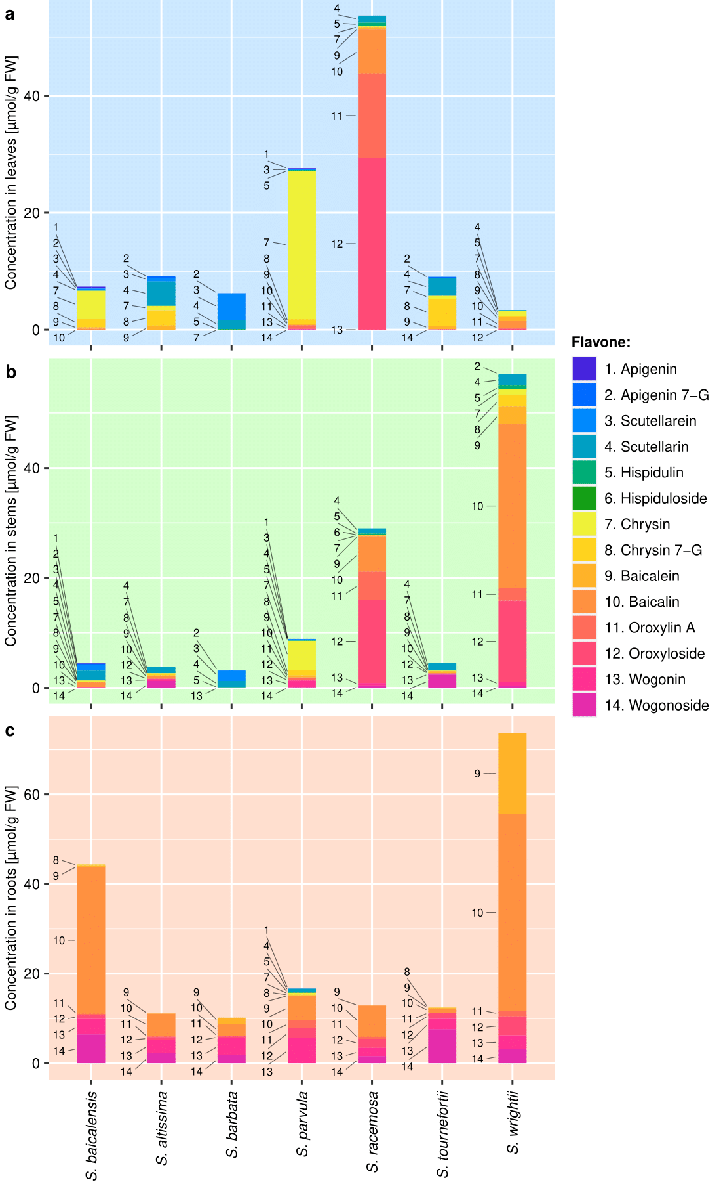
Figure 2. Metabolite data collected from the (a) leaves, (b) stems, and (c) roots of 7 Scutellaria species via High Performance Liquid Chromatography (HPLC). Samples were taken in biological triplicate, and the average concentration of each metabolite calculated. Metabolites are numbered to match their order of occurrence in the flavone pathway, shown in Figure 1.

Slide 3
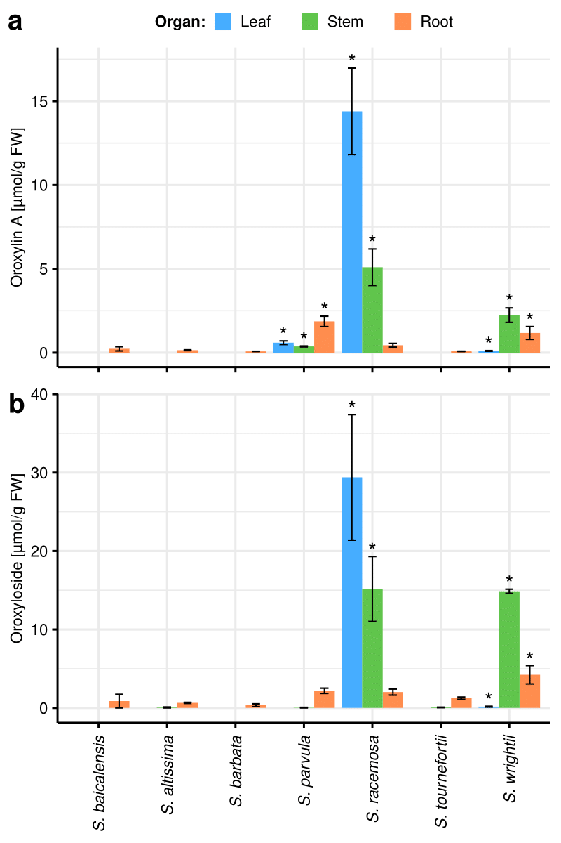
Figure 3. Organ-specific (a) oroxylin A and (b) oroxyloside concentrations in 7 Scutellaria species, as determined via High Performance Liquid Chromatography (HPLC). Concentrations were averaged from tissue samples taken from 3 biological replicates, and error bars represent standard error. Asterisk (*) indicates p-value < 0.05 relative to S. baicalensis for the same organ and flavone.

Slide 4
75.0
S. barbata
S. baicalensis
S. racemosa
60.0
40.0
Absorbance, λ = 276 nm [mAU]
20.0
0.0
5.25
5.50
5.75
6.00
6.25
5.25
5.50
5.75
6.00
6.25
5.25
5.50
5.75
6.00
6.25
Time [min]
Time [min]
Time [min]
Figure 4. Comparison of chromatograms collected via HPLC from S. barbata, S. baicalensis, and S. racemosa stems. Time interval displayed was selected to center the unknown peak in the chromatograms.

Slide 5
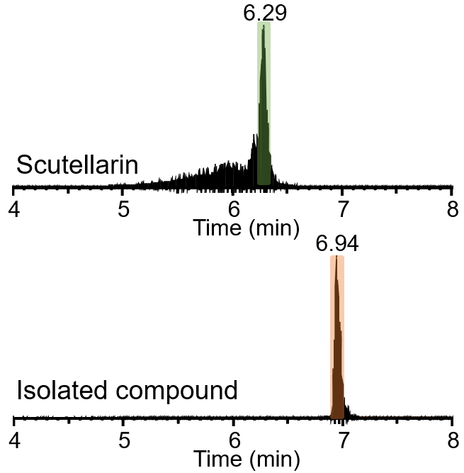
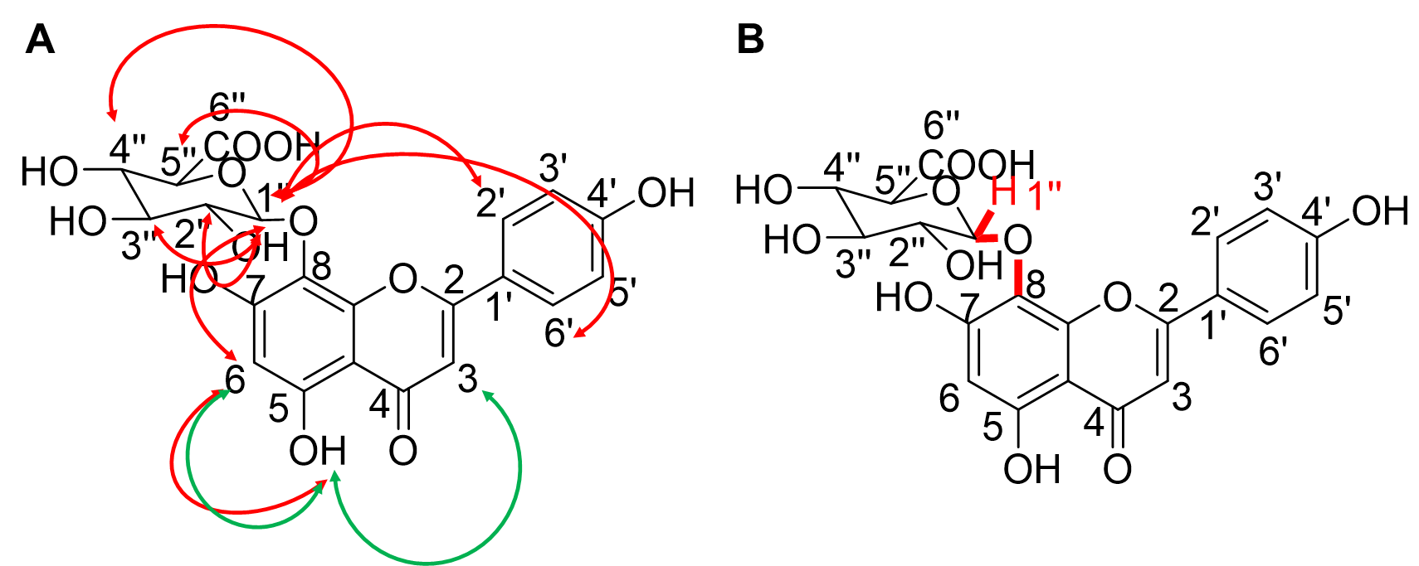
a
b
Figure 5. Characterization of a new scutellarin isomer. (a) Standard scutellarin and isolated compound were eluted with different retention times in LC-HRMS analysis. (b) Key NMR correlations of isolated compound. 1D-NOESY and1D-ROESY correlations are represented by red and green two-way arrows, respectively (left). A three-bond HMBC correlation from H-1’’ to C-8 (right).

Slide 6
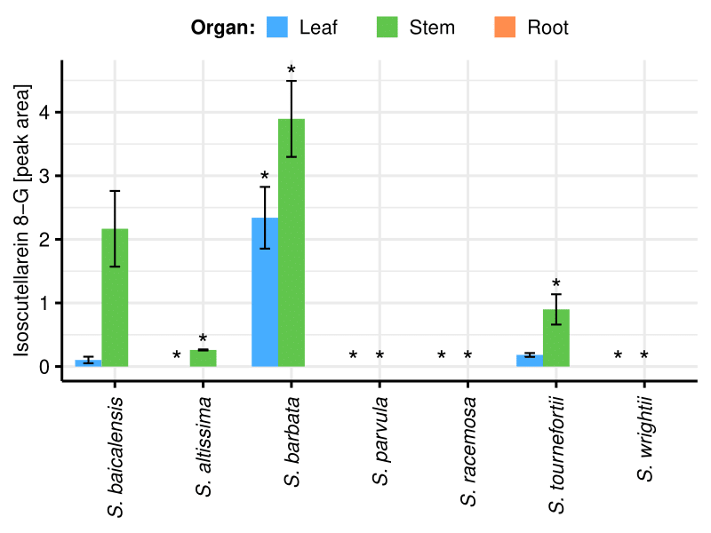
Figure 6. Organ-specific isoscutellarein 8-glucuronide peak areas in 7 Scutellaria species, as determined via High Performance Liquid Chromatography (HPLC). Peak areas were averaged from tissue samples taken from 3 biological replicates, and error bars represent standard error. Asterisk (*) indicates p-value < 0.05 relative to S. baicalensis for the same organ and flavone.

